Slide 1
SQL Subqueries

Slide 2
A SQL subquery, also known as a nested query or inner query, is a query within another SQL statement.
It allows you to use the result of one query as input in another query. Subqueries are enclosed in parentheses and can be used in various parts of a SQL statement, including SELECT, FROM, and WHERE clauses.
They are a powerful tool for retrieving and manipulating data.

Slide 3
When you would use it
Retrieve data based on the result of another query: Use the output of one query as a filter or criteria for another query.
Simplify complex queries: Break down complex problems into smaller, more manageable subqueries to improve query readability and maintainability.
Perform aggregation within a query: Calculate aggregate functions on a subset of data, such as finding the average, sum, or maximum value.
Make comparisons: Compare values between tables or within the same table to find matching or non-matching records.

Slide 4
Syntax
SELECT column_name FROM table_name WHERE column_name expression operator (SELECT column_name FROM table_name WHERE …);
Example
Use a subquery to select the first name of the customer with the highest age
SELECT first_name
FROM Customers
WHERE age= (
//subquery
SELECT MAX(age)
FROM CUSTOMERS
);

Slide 5
Example: Select Customers with Minimum Age Using Subquery
Select all the rows from the Customers table with the minimum age
SELECT * FROM Customers
WHERE age = (
SELECT MIN(age)
FROM Customers
);

Slide 6
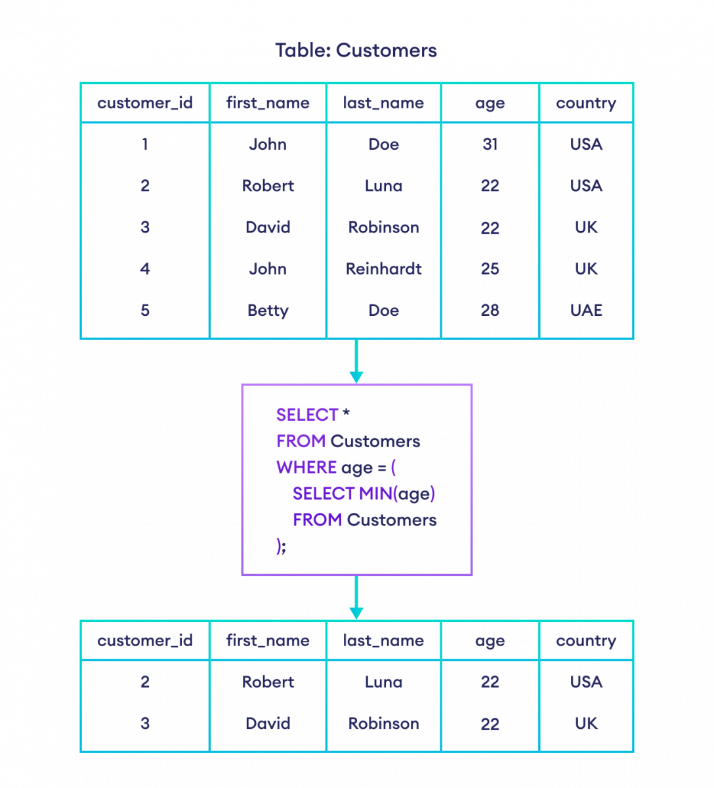

Slide 7
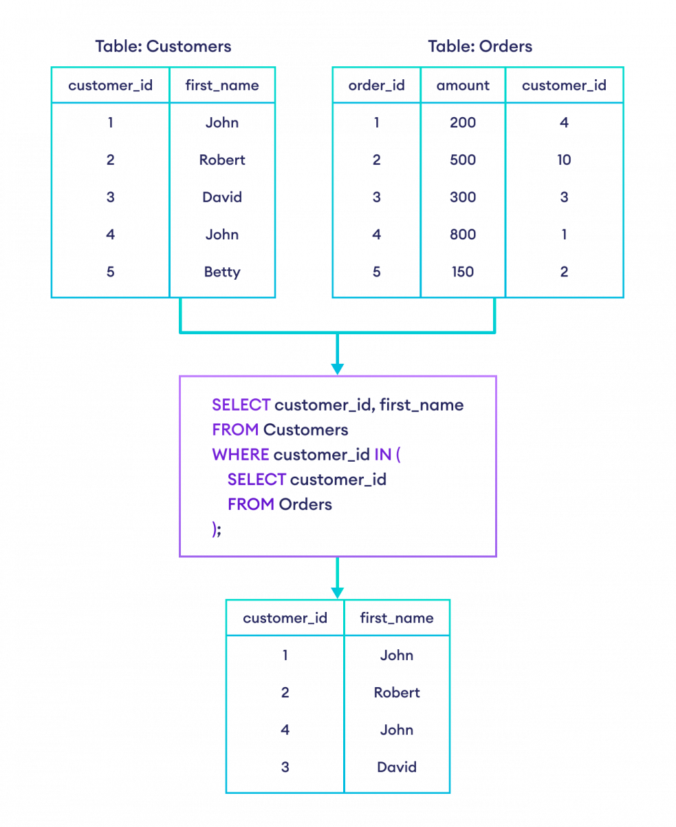
Example: Suppose we want the details
of customers who have placed an order.
SELECT customer_id, first_name
FROM Customers
WHERE customer_id IN (
SELECT customer_id
FROM Orders
);

Slide 8
Example
Suppose you have a database with two tables, "employees" and "departments," and you want to retrieve the names of employees in the "Sales" department.
You can use a subquery like this:
SELECT employee_name
FROM employees
WHERE department_id = (SELECT department_id FROM departments WHERE department_name = 'Sales');

Slide 9
SQL JOINS
The SQL JOIN statement is used to combine rows from two tables based on a common column and selects records that have matching values in these columns.
Syntax:
SELECT columns_from_both_tables
FROM table1
JOIN table2
ON table1.column1 = table2.column2
Here, table1 and table2 are the two tables that are to be joined, column1 is the column in table1 that is related to column2 in table2.

Slide 10
Example : join the Customers and Orders tables based on the common values of their customer_id columns
SELECT Customers.customer_id, Customers.first_name, Orders.amount
FROM Customers
INNER JOIN Orders
ON Customers.customer_id = Orders.customer;

Slide 11
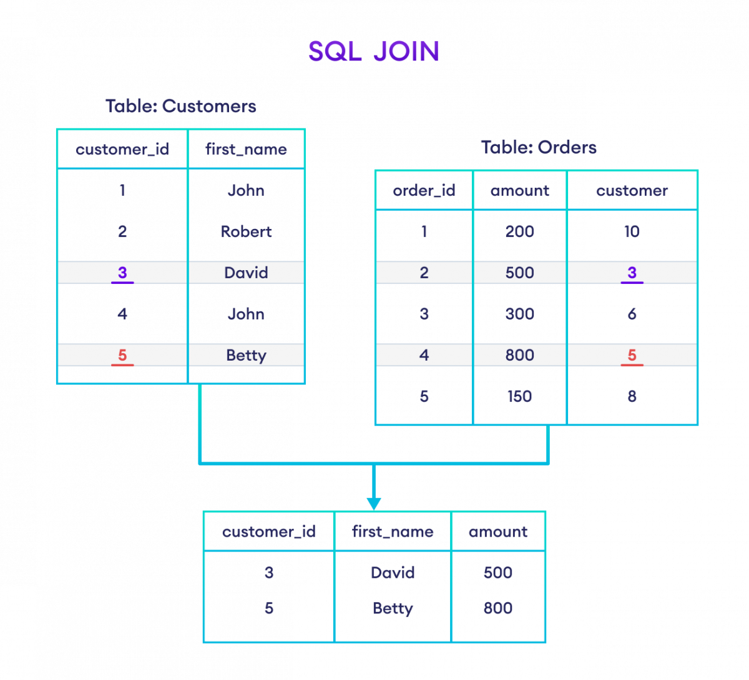

Slide 12
Here's an example of INNER JOIN with the WHERE clause:
Join Customers and Orders table with customer_id and customer fields. Here, the SQL command joins two tables and selects rows where the amount is greater than or equal to 500.
SELECT Customers.customer_id, Customers.first_name, Orders.amount
FROM Customers
INNER JOIN Orders
ON Customers.customer_id = Orders.customer
WHERE Orders.amount >= 500;

Slide 13
SQL LEFT JOIN
Example: Left join the Customers and Orders tables
SELECT Customers.customer_id, Customers.first_name, Orders.amount
FROM Customers
LEFT JOIN Orders
ON Customers.customer_id = Orders.customer;

Slide 14
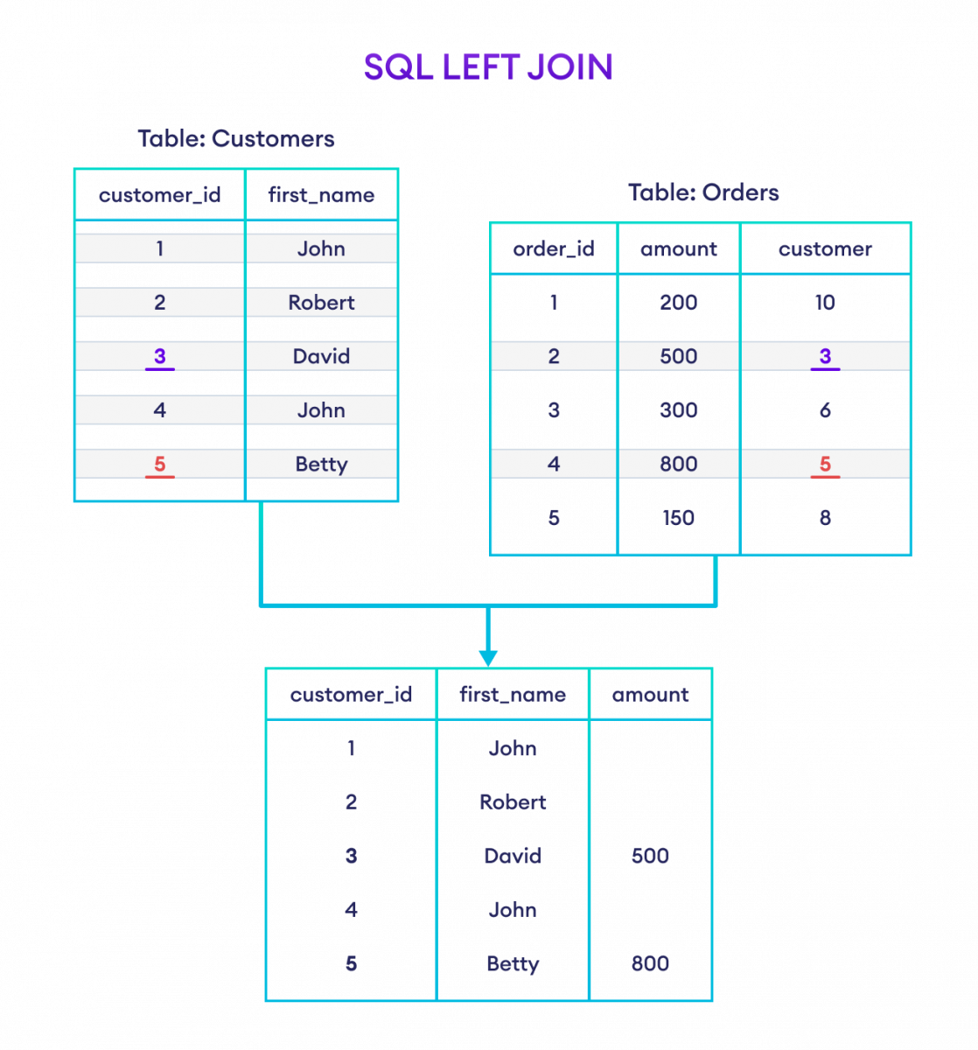

Slide 15
SQL RIGHT JOIN
Example: Join Customers and Orders tables based on customer_id of Customers and customer of Orders.
SELECT Customers.customer_id, Customers.first_name, Orders.amount
FROM Customers
RIGHT JOIN Orders
ON Customers.customer_id = Orders.customer;

Slide 16
